Slide 1
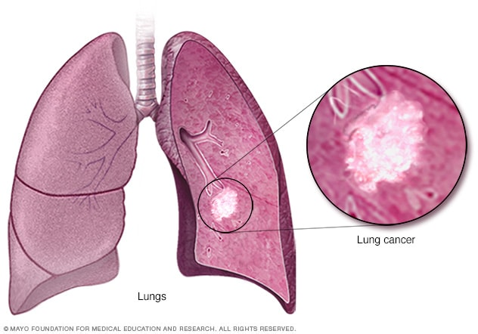
Analysis of Lung Cancer Incidence, Mortality and Risk Factors in the United States
Group 3

Slide 2
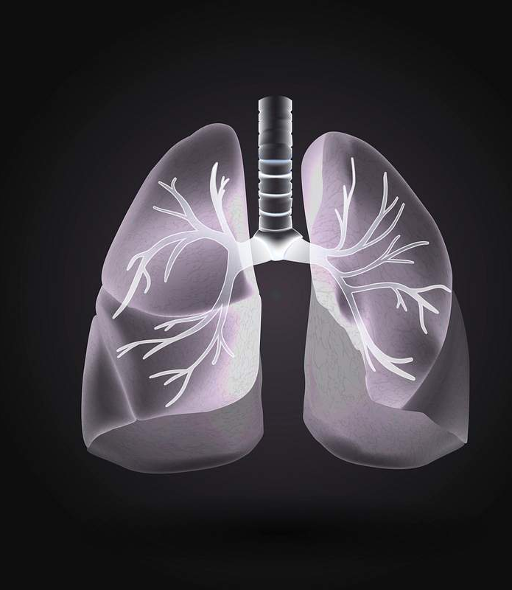
HDS 5230-05 High Performance Computing and Health Artificial Intelligence Instructor : Prof . Bahareh Rahmani Group : 03
Group Members :
Dr. Pala Jijol Onesimos – Resident Doctor (MD.FCCM.)
Shreya Shrestha – Public Health Practitioner
Dhwani Mehta – Biotechnologist
Sahil Patel - Chemist
Sohil Chaudhary - Registered Nurse

Slide 3
Table of Contents
Project Definition
Data Definition
Data Sources
Data Collection
Data Description
Data Attributes

Slide 4
Project Definition
Project Objective:
To analyze lung cancer incidence and mortality across U.S. counties and identify demographic, behavioral, and screening-related factors associated with lung cancer burden.
Problem Statement:
Lung cancer remains a leading cause of cancer-related deaths in the United States. Understanding population-level patterns can support improved screening, prevention, and public health planning.

Slide 5

Data Definition
Data consists of population-level, aggregated health records related to lung cancer.
Each dataset represents county-level measurements across multiple years.
Variables include cancer outcomes, geographic identifiers, and risk indicators.
Data is structured in CSV (.csv) format, suitable for statistical and machine learning analysis.

Slide 6

Data Description
Type of Data:
Population-level, aggregated data
County-level (U.S.)
Publicly available government datasets
Data Format:
CSV (.csv) files
Time Coverage:
Multiple recent years (depending on dataset)
Data Source:
NIH; National Cancer Institute

Slide 7
Data Collection Method
Data were collected from official U.S. cancer surveillance systems.
County-level datasets were downloaded directly from public data portals.
Data files were obtained in CSV format for reproducibility.
No personal identifiers are included, ensuring ethical data use.

Slide 8
Data Description
The datasets contain population-level lung cancer data collected from U.S. cancer surveillance systems.
Data is aggregated at the county level across the United States.
Each dataset is structured in CSV (.csv) format.
The data includes information on lung cancer incidence, mortality, and associated risk indicators.
These datasets are suitable for exploratory analysis, statistical modeling, and machine learning.

Slide 9
Unit of Observation and Data Coverage
Unit of Observation: Each row represents a county–year combination.
Geographic Coverage: United States (county-level data).
Time Coverage: Multiple recent years (varies by dataset).
Population: Adult population in the United States.

Slide 10
Data Attributes
Geographic and Time Variables
county_fips – County identification code
state_name – U.S. state
county_name – County name
year – Year of observation
Outcome Variables
lung_cancer_incidence_rate
lung_cancer_mortality_rate
Risk and Screening Variables
smoking_prevalence
screening_indicator
Behavioral risk measures (e.g., smoking-related metrics)

Slide 11
Data Format
File format: CSV (.csv)
Rows represent county-level observations
Columns represent lung cancer outcomes, geographic identifiers, and risk factors
Data can be analyzed using:
Python (Pandas)
R
Excel
Statistical and machine learning tools

Slide 12
Data Sources
National Cancer Institute (NCI) – State Cancer Profiles Lung cancer incidence data https://statecancerprofiles.cancer.gov/incidencerates/
Centers for Disease Control and Prevention (CDC) Lung cancer mortality data https://statecancerprofiles.cancer.gov/deathrates/
CDC-supported Risk Indicator Data Smoking and behavioral risk indicators https://statecancerprofiles.cancer.gov/risk/
All datasets were downloaded in CSV (.csv) format

